Slide 1

Internship Project
Data Storytelling
& Statistical Validation
Book Market Analysis
Presented by
Focus Areas
Megha
Reader Engagement • Pricing Impact • Genre Performance

Slide 2
Business Context
Objective of Analysis
The goal of this analysis is to understand the key factors influencing reader engagement and customer satisfaction in the book market.
Why This Matters
Understanding these dynamics helps businesses make better strategic decisions across multiple dimensions:
Key Questions We Aim to Answer
1
Does pricing impact customer ratings?
Pricing Strategy
Content Strategy
Market Positioning
Optimize price points
Focus on high-performing genres
Competitive advantage
2
Which genres drive higher engagement?
3
What factors influence reader behavior?

Slide 3
Data Foundation
Dataset Summary
298
29M+
4.67
$11.66
Total Books
Total Reviews
Average Rating
Average Price
Best-selling titles analyzed
Reader feedback aggregated
High customer satisfaction
Market pricing benchmark
Dataset Composition
Data Processing
The dataset includes comprehensive book details essential for market analysis:
Data was cleaned and transformed using SQL before analysis to ensure accuracy and reliability.
Book Title
Genre Category
Missing values handled
Price Information
Customer Ratings
Data formatting standardized
Review Counts
Quality validation completed

Slide 4
Methodology
Approach & Methodology
1
2
3
4
5
Data Cleaning
Exploratory Data Analysis
Feature Engineering
Dashboard Development
Statistical Validation
Handling missing values, formatting inconsistencies, and ensuring data quality for reliable analysis.
Creating meaningful categories like price segments and review tiers for deeper analytical insights.
Testing hypotheses and validating findings through rigorous statistical methods to ensure reliability.
Understanding data distributions, identifying patterns, and uncovering initial insights through visualization.
Building interactive Power BI dashboards for dynamic exploration and stakeholder communication.
Integrated Analytical Framework
The analysis combines SQL-based data processing with visual insights and statistical reasoning to deliver comprehensive, evidence-based conclusions that drive business decisions.

Slide 5
Discoveries
Key Findings from Analysis
Genre Performance Leader
Price Distribution Pattern
Fiction & Action genres drive the highest engagement with the largest total review volumes, indicating strong reader interest and market demand.
The majority of books fall under the medium price range, suggesting a balanced market positioning strategy across publishers.
Consistent Rating Quality
Price-Rating Independence
Ratings remain consistently high (~4.6+) across all genres, demonstrating stable customer satisfaction regardless of book category.
Price does not significantly influence ratings, indicating that customer satisfaction is driven by content quality rather than cost.
Key Takeaway: Customer satisfaction remains stable across all dimensions, suggesting that content quality and genre alignment matter more than pricing strategy.

Slide 6
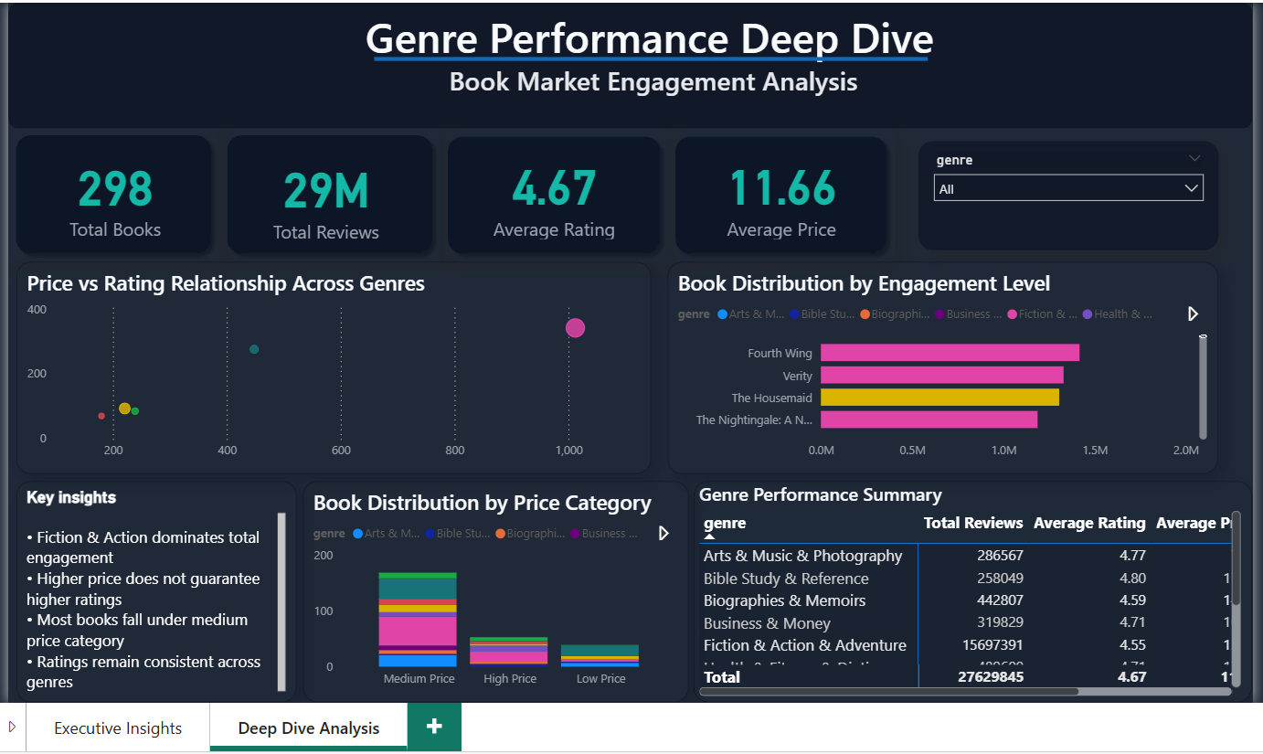
Visualization
Interactive Dashboard
Dashboard Components
KPI Tracking
Total Books, Reviews, Rating, Price metrics
Genre Analysis
Performance breakdown by category
Price vs Rating
Relationship visualization
Interactive Filters
Dynamic slicers for exploration
Business Impact
Interactive Power Bi dashboard used to explore genre performance, pricing trends and engagement patterns.
The dashboard enables dynamic exploration of insights and supports data-driven decisions through real-time filtering and visualization capabilities.

Slide 7
Statistical Framework
Hypothesis Testing
Research Question
We aim to test whether pricing influences customer satisfaction in the book market.
H₀
Null Hypothesis
H₁
Alternative Hypothesis
Price has no significant impact on book ratings
Price significantly impacts book ratings

Slide 8
Statistical Evidence
Price vs Rating Analysis
Low Price Category
Medium Price Category
High Price Category
~4.70
~4.62
~4.76
Average Rating
Average Rating
Average Rating
Statistical Interpretation
Key Observation
No strong variation indicates a weak relationship between price and rating.
Differences in average ratings across price categories are minimal
Ratings remain stable
Rating Range
4.62 - 4.76
Price is not a predictor
Only 0.14 point difference
Other factors dominate

Slide 9
Findings
Final Conclusion
Primary Finding
The analysis shows that pricing has minimal impact on customer satisfaction in the book market.
Rating Consistency
Key Drivers
Customer ratings remain consistently high across all price categories, demonstrating that readers value content quality over cost.
Other factors like genre and content quality influence reader engagement more significantly than price.
4.6+
Genre
Quality
Average across all price tiers
Primary driver
Content value
Insight: The book market demonstrates that customer loyalty and satisfaction are built on content excellence, not pricing strategies.

Slide 10
Strategic Actions
Recommendations
Focus on Content Quality
Invest in High-Performing Genres
Maintain Competitive Pricing
Prioritize content quality and genre alignment, as there have a greater impact on engagement than pricing.
Allocate more resources to Fiction & Action genres that demonstrate highest reader engagement and review volumes.
Keep prices competitive without overemphasis on premium pricing. Focus on value perception rather than cost positioning.
Quality drives satisfaction more than price
These genres show strongest market demand
Price is not a key differentiator
Business Impact
These insights help optimize product strategy and improve market positioning by focusing resources on what truly matters to readers: exceptional content in popular genres at fair prices.

Slide 11

Summary
Key Takeaways
Genre is the Primary Driver
Ratings Are Stable Across Categories
Genre selection significantly influences reader engagement, with Fiction & Action leading the market.
Customer satisfaction remains consistently high (~4.6+) regardless of genre or price point.
Price is Not a Major Factor
Strong and Consistent Market Demand
Pricing has minimal impact on customer satisfaction, indicating content quality matters more.
The book market demonstrates robust demand with 29M+ reviews across 298 best-selling titles.
Success in the book market comes from exceptional content in popular genres, not pricing strategies.

